Slide 1
Topological Sort
By Shobhit

Slide 2
Outline:
Applications
Overview
DFS based solution
Kahn’s Algorithm

Slide 3
Applications:
1.Topological Sorting is mainly used for scheduling jobs from the given dependencies among jobs.
2. Instruction scheduling
3. Determining the order of compilation tasks to perform in makefiles
4. Data serialization
5. Course Schedule

Slide 4
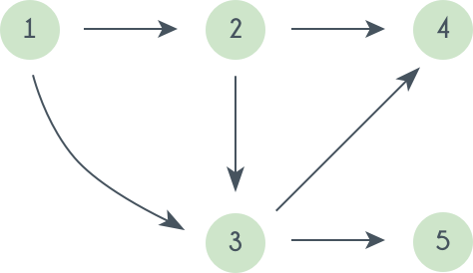
Overview:
Topological order:
1,2,3,4,5
1,2,3,5,4

Slide 5
DFS Based Solution:
We have to take visited set, adjacency list, stack.
visited set: to identify whether the vertex is already visited or not
adjacency list: to know the adjacent vertices of the particular vertex
stack : when we recursively explore the all the adjacent of the vertex then we push into the stack.

Slide 6
cont..
Void topologicalSortUtil(int v, bool visited[], stack<int> &Stack)
{
// Mark the current node as visited.
visited[v] = true;
// Recur for all the vertices adjacent to this vertex
vector<int>::iterator i;
for (i = adj[v].begin(); i != adj[v].end(); ++i)
if (!visited[*i])
topologicalSortUtil(*i, visited, Stack);
// Push current vertex to stack which stores result
Stack.push(v);
}

Slide 7
Kahn’s Algorithm:
Data structure required:
Indegree array: to store the indegree of every vertex
Queue: push those elements which have indegree 0
Adjacent list: to know the adjacent vertices of the particular vertex
Output array: to store the result

Slide 8
Implementation:
https://github.com/shobhit-saini/Leet_Code/blob/master/Topological_sort/207.Course_Schedule.cpp

Slide 9
Thank You

